Slide 1
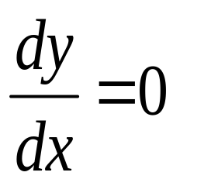
Optimisation
In real life we are often concerned with the maximum and minimum situations e.g. maximum profit, minimum cost, maximum speed and etc.
These real life maxima and minima can be determined using differentiation
Optimisation problems:
minimum and maximum -->

Slide 2

Solving optimisation problems
If a diagram is not given then draw one if it helps
Identify the variable that is to be maximised, or minimised. If this variable is C then you must find an equation with C as the subject (C = ???..)
If this equation for C involves two variables (other than C) find another equation that will allow us to substitute for one of the variables.
Then find the values of x for which dC/dx = 0
Use the second derivative to determine the nature (min or max)

Slide 3
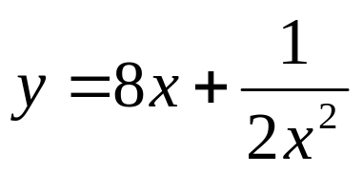
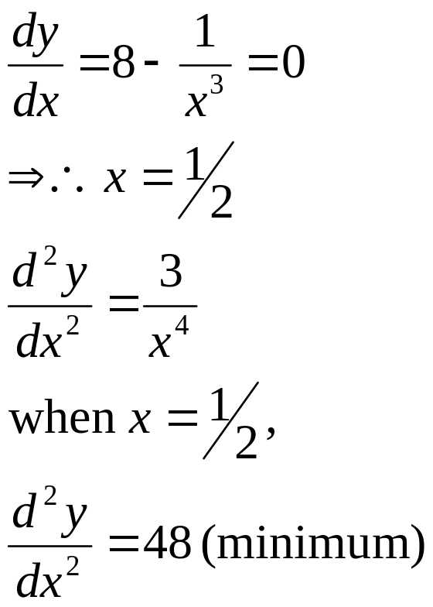
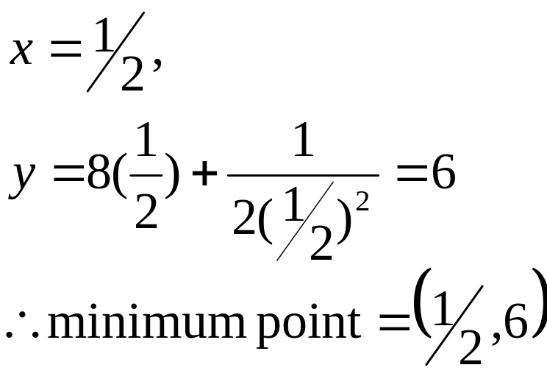
Optimisation Problems
Find the coordinate of the turning point of the curve and determine the nature of the point.
Solution:

Slide 4
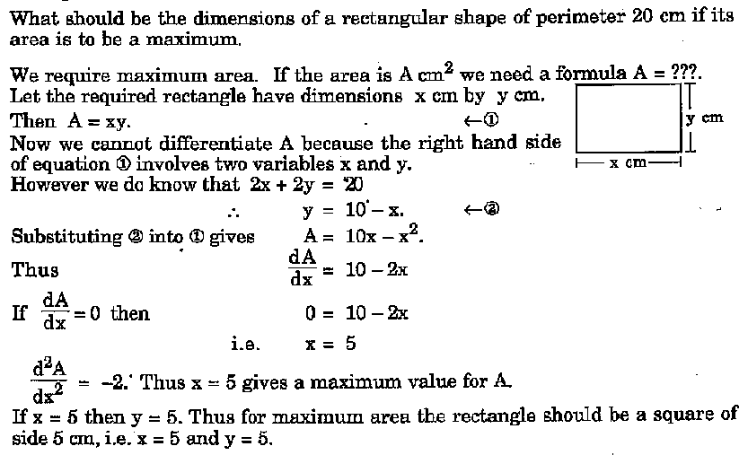
Optimisation Problems

Slide 5
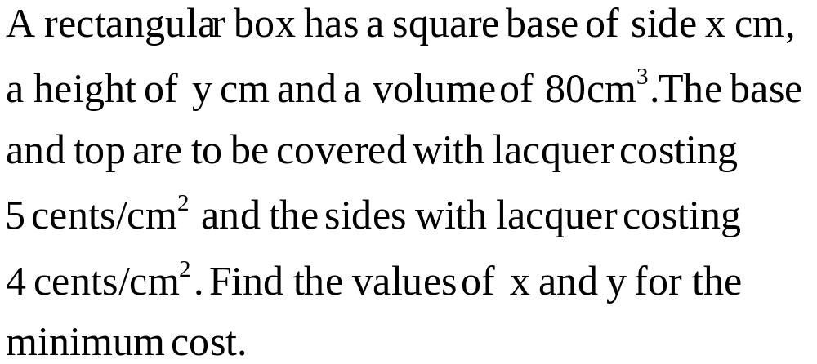
Optimisation Question
Answer: x = 4, y = 5

